Slide 1
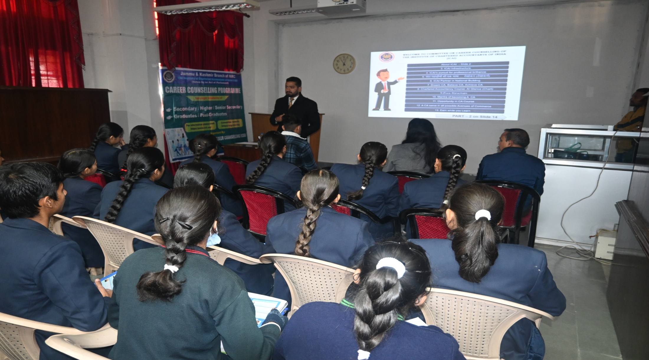
CAREER GUIDANCE & COUNSELING PROGRAMME
(for Medical & Non -medical students
By Mr. Ashish Jalotra , Senior Research Fellow ,Dept. Of Physics, University of Jammu)

Slide 2
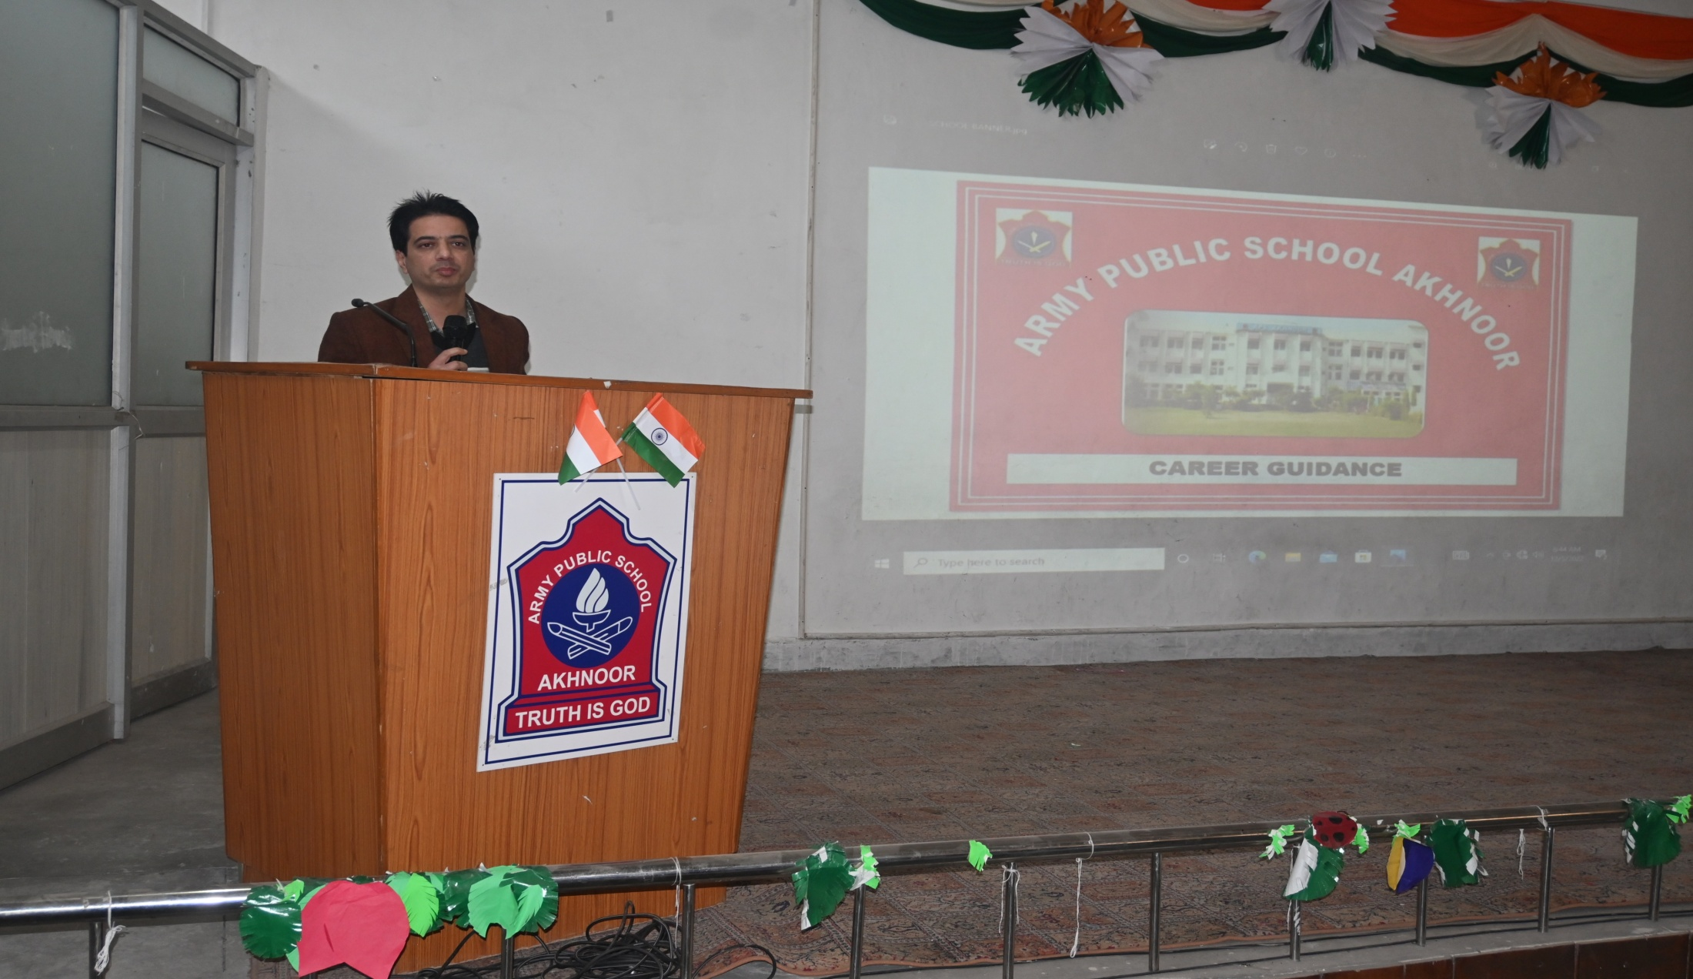
CAREER GUIDANCE & COUNSELING PROGRAMME
( For humanities Students By Mr. Anirudh Khajuria, Chief Accounts Officer, PWD & RNB Jammu)

Slide 3
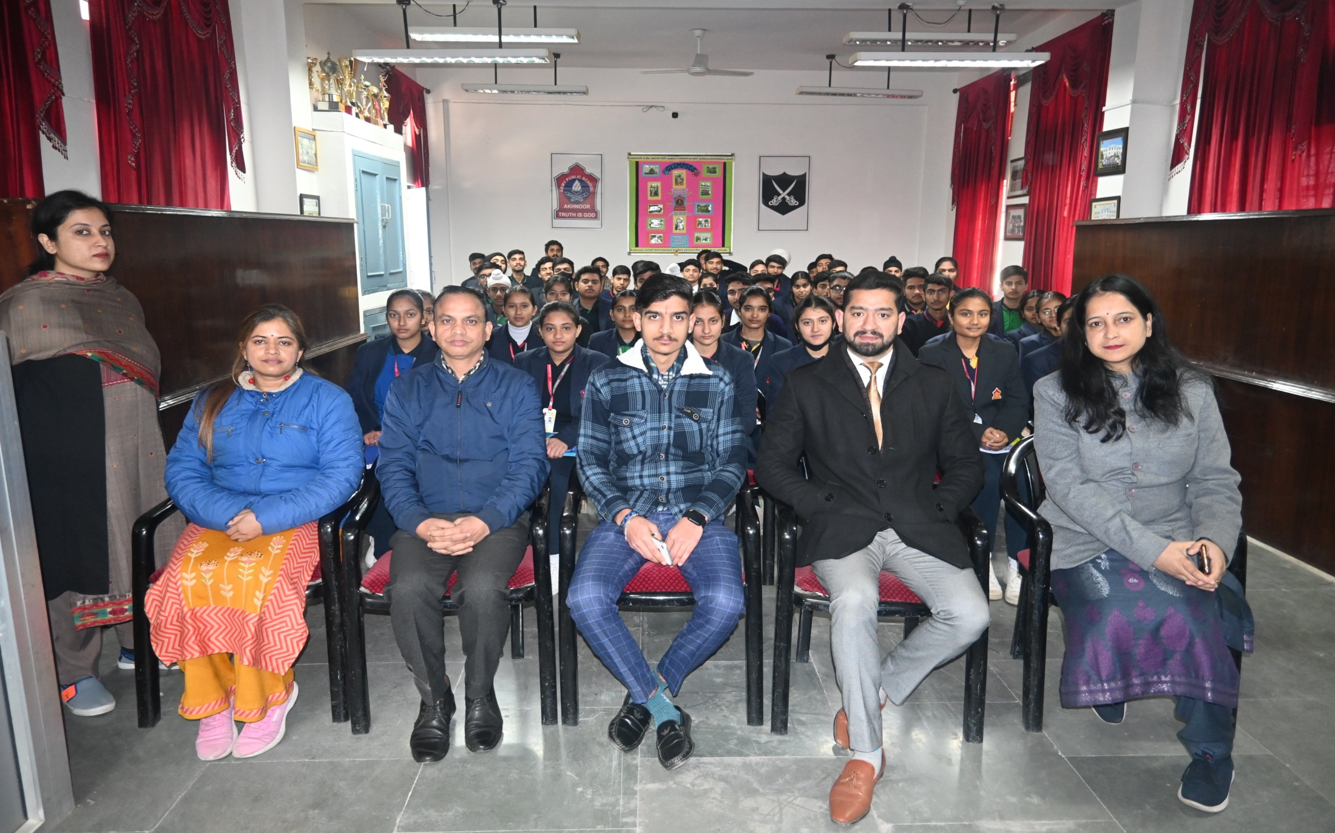
CAREEr GUIDANCe & COUNSELING PROGRAMME
(For XI & XII Commerce Students By Mr. Vineet Kohli, CA)

Slide 4
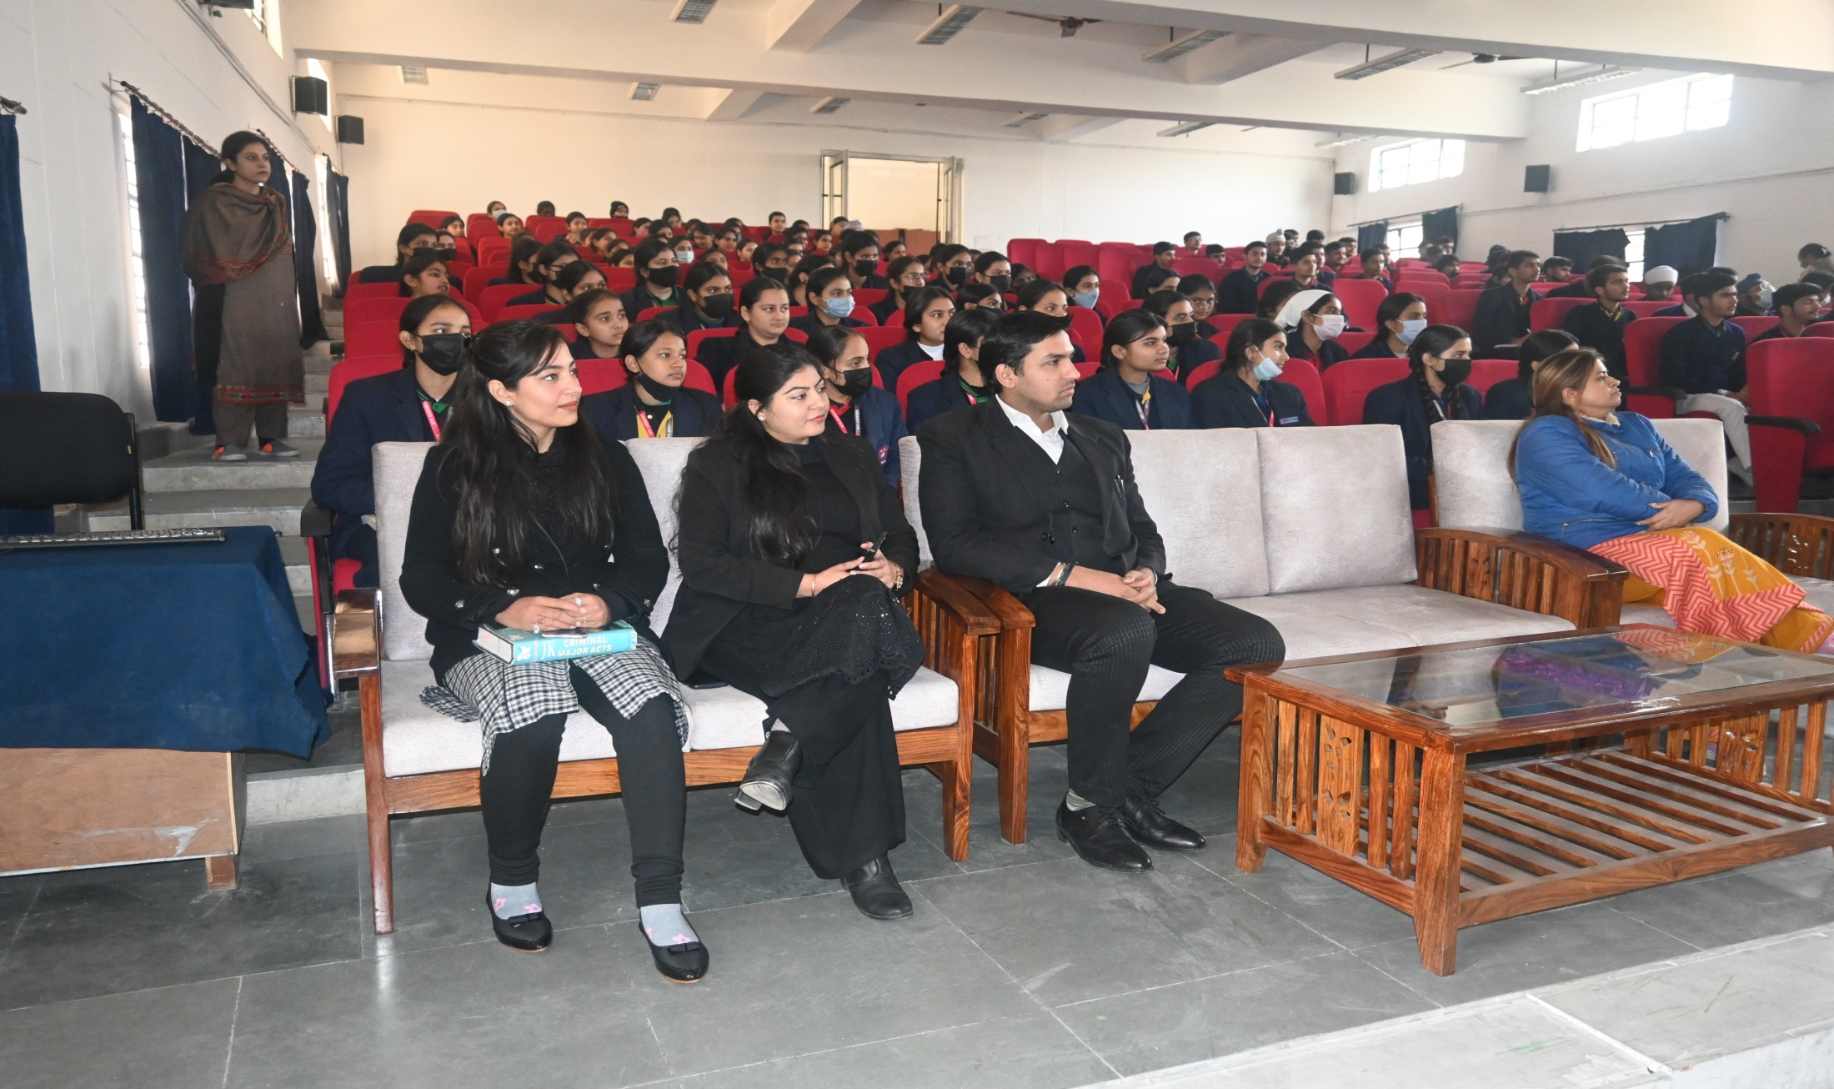
CAREER GUIDANCE & COUNSELING PROGRAMME
( For Medical, Non-Medical & Humanities Students By Mr. Sunil Khajuria, Advocate, Jammu High Court )

Slide 5
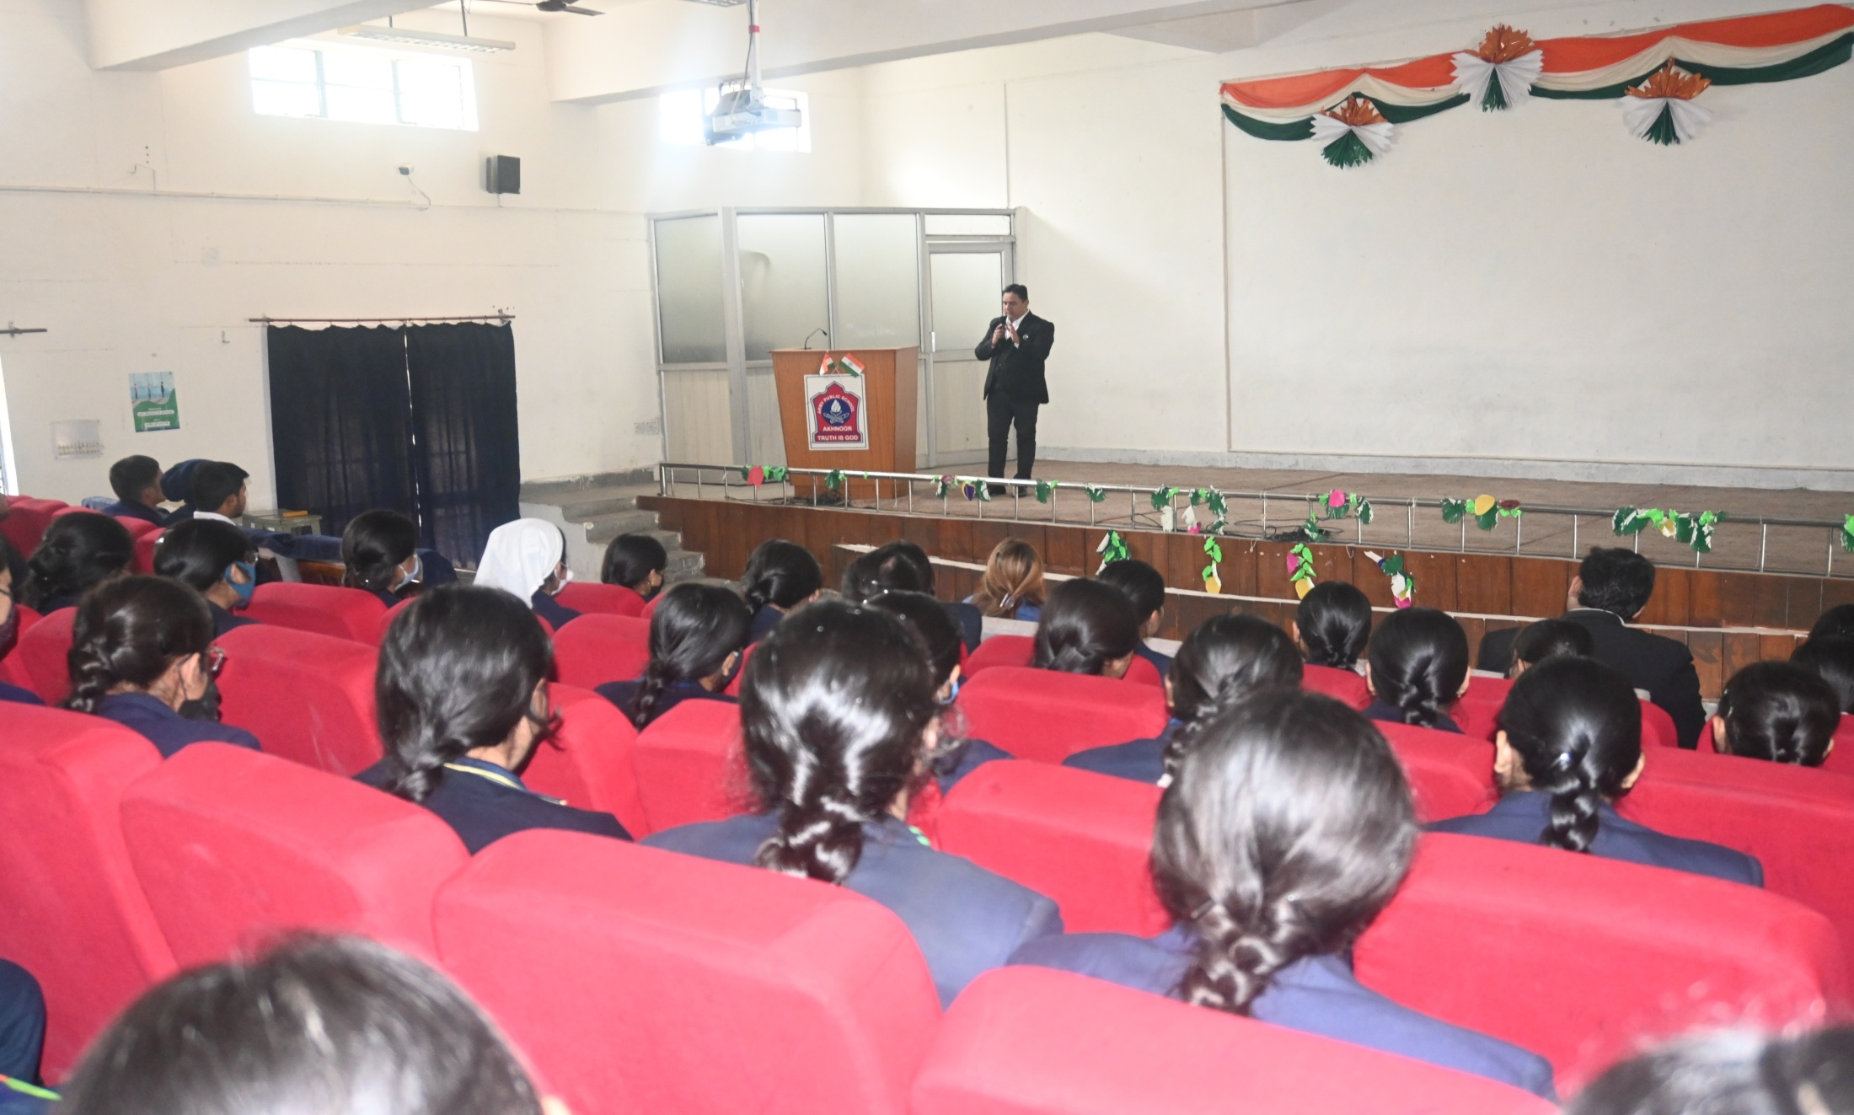
CAREER GUIDANCE & COUNSELING PROGRAMME
( For Medical, Non-Medical & Humanities Students By Mr. Sunil Khajuria, Advocate, Jammu High Court )

